Slide 1
Defending against Sybil Devices in Crowdsourced Mapping Services
Gang Wang, Bolun Wang, Tianyi Wang, Ana Nika,
Haitao Zheng, Ben Y. Zhao
UC Santa Barbara
bolunwang@cs.ucsb.edu

Slide 2
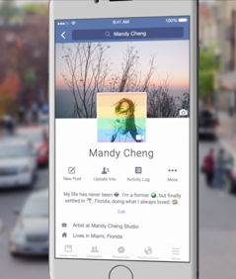
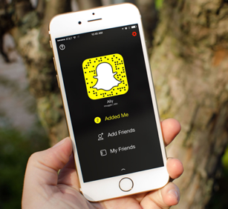
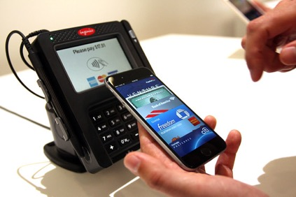
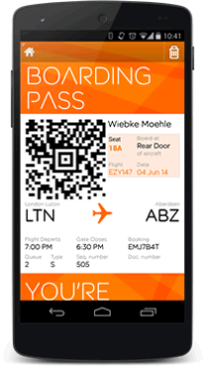
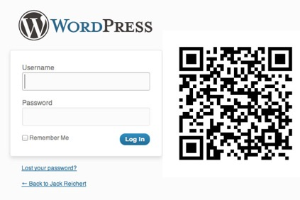
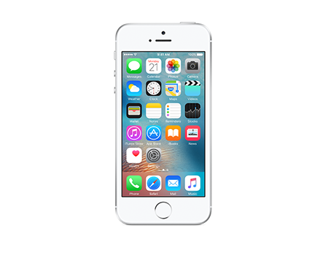

Mobile = Life
Mobile phones for content, payment, authentication
Mobile devices are virtual representations of ourselves.
=

Slide 3
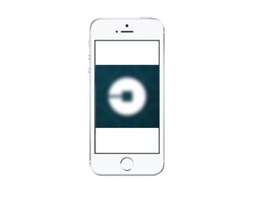
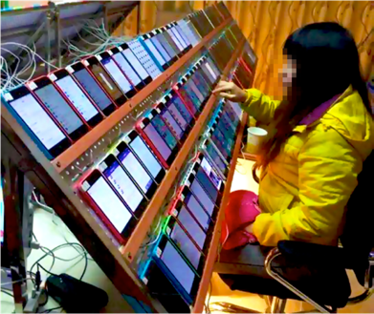

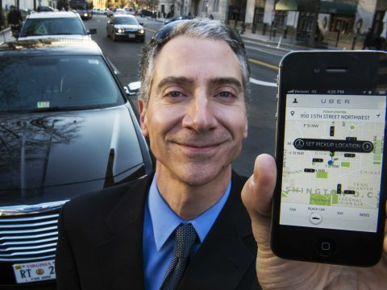
But Is This a Safe Assumption?
App User = real phone + real person?

Slide 4



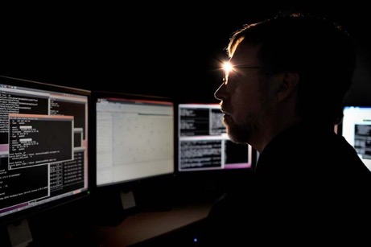

Can We “Authenticate” Devices?
Register via email account
Require CAPTCHAs
2FA via phone number
Validate IMEI number
Create fake email account
Out-source to third party
Temporary SMS services
Spoofed IMEI

Slide 5
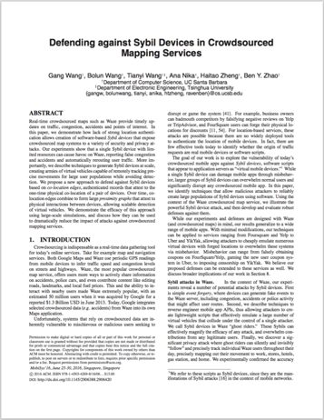
In This Talk
Sybil device problem
  Software scripts emulating as real devices
  Allowing a single user to control many devices
In the context of Waze (popular navigation app)
  Techniques generating Sybil devices
  Attacks on Waze: injecting fake events, user location tracking
  Defense against Sybil devices
The story between us and Waze
Broader implications
Not in paper

Slide 6

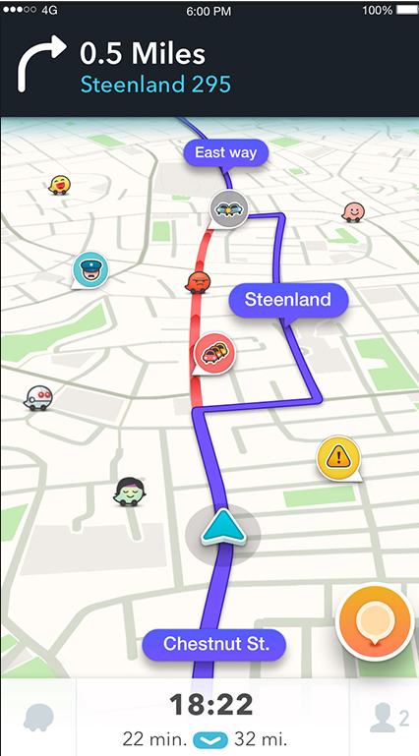
Key Features
50M active users
Real-time traffic update using millions of users’ locations
User reported events
Accidents, construction, police cars, etc.
Alert user of nearby events
Social features
See nearby users on the map
Say “hi” and message nearby users

Slide 7
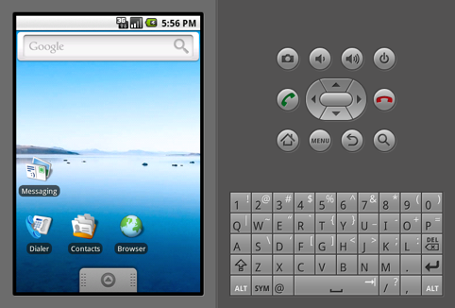
Sybil Devices in Waze
Sybil devices have significant impact on Waze
  Inject fake data, retrieve sensitive information
Existing work: mobile emulators
  Two Israeli students used emulators to created fake traffic jams in 2014
  Not scalable: ~10 emulators per PC
Virtualize devices using scripts
  Scalable: 1,000 – 10,000 Sybil devices per server
  Overwhelm normal users’ data
  Launch special large scale attacks

Slide 8







Create Sybil Devices using Script
Intuition
  Goal: emulate a full mobile client
  Server communicates with client via limited APIs
  Mimic API calls to replace full client
Plaintext traffic
Controlled by us
HTTPS
HTTPS
HTTPS
Waze Client
HTTPS Proxy
Waze Server
We can create 10,000 Sybil devices on a single PC

Slide 9





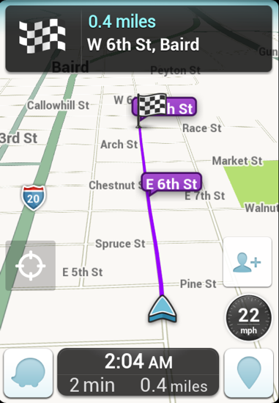
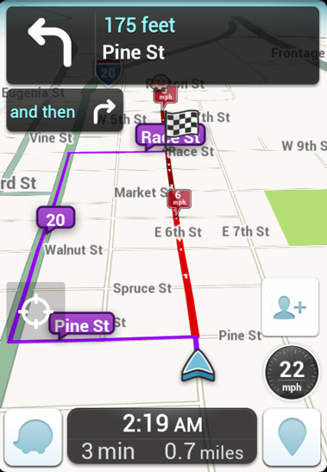
Attack #1: Polluting Waze Database
Fake road-side events.
  Any type of event at any location
  Potentially affect 1+billion Google Maps users
Fake traffic hotspots
  Simulate cars driving slowly
  Large groups of Sybil devices to overwhelm normal users’ data
Users are re-routed
Before
After

Slide 10
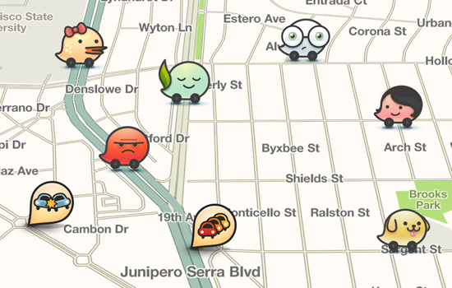
Attack #2: User Location Tracking
Follow (stalk) any Waze user in real-time
  Waze marks nearby users on the map
Pinpoint to exact GPS location
  Specific hotels, gas stations, etc.
Remain invisible
  Move in and out quickly
Track users in the background
  Waze uploads GPS in the background
Track users across days
  Use creation time as GUID

Slide 11
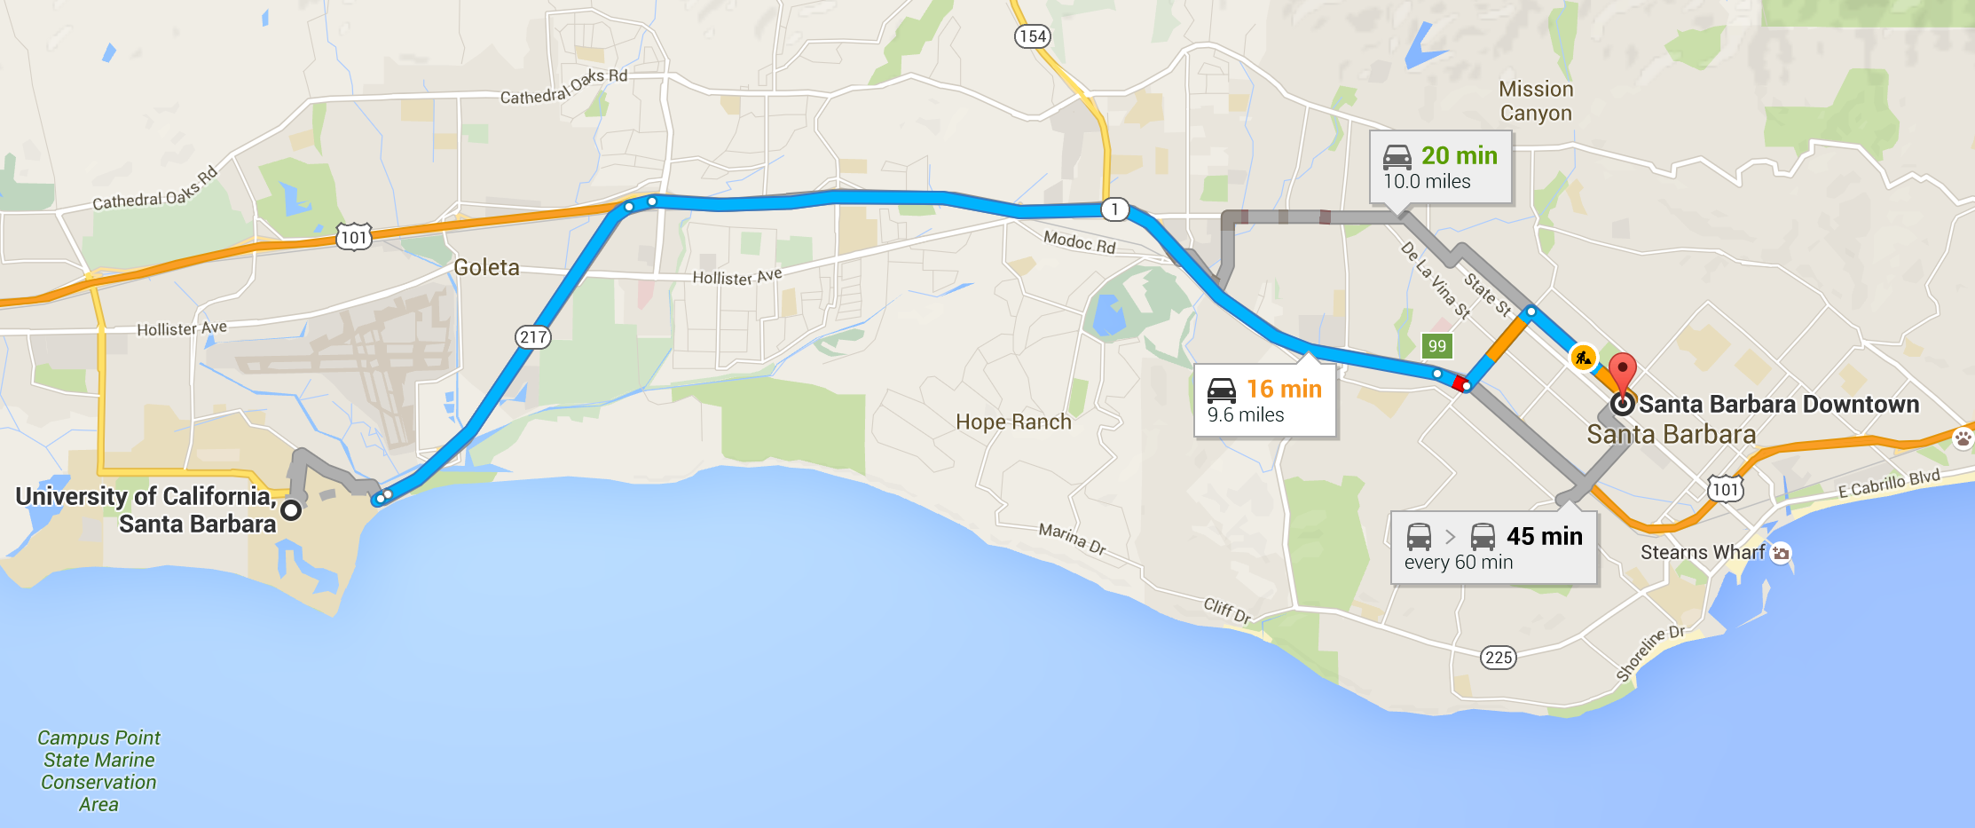


A Tracking Example

Slide 12
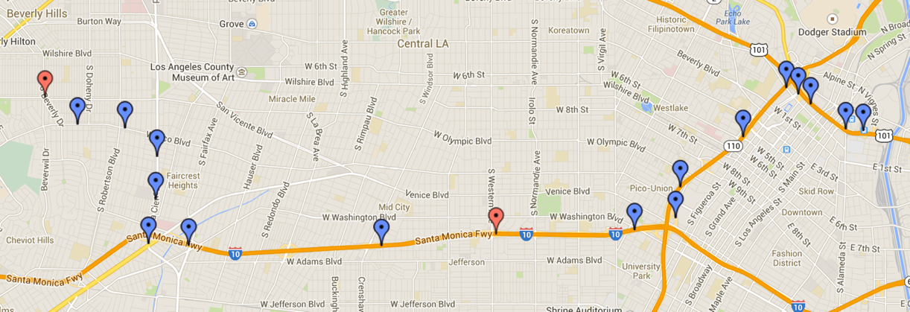
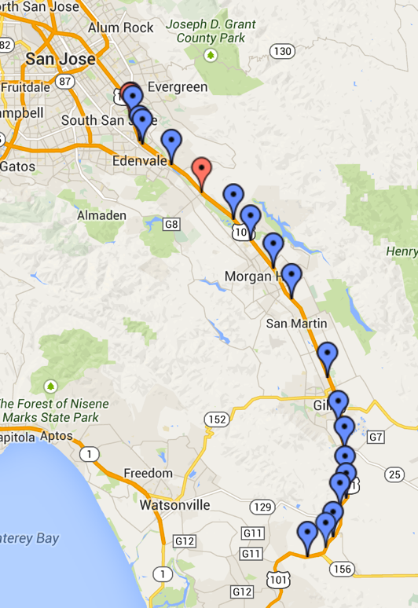


Tracking Experiments
Extremely dense user population
Fast moving target user
Highway 101
LA downtown
GPS Captured
GPS Missed
Tracking attack is
effective and practical

Slide 13
The Story of Us and Waze

Slide 14









Conversation with Waze
Notify Waze and Google
Nov. 14 2014
1st code change: remove background GPS upload
Pitch work to Fusion
Oct. 18 2015
Fusion report on tracking
Media attention
Apr. 16 2016
Apr. 26 2016
+21 more
Public PR release
2nd code change: disable social function
Apr. 27 2016
More news coverage
+16 more
May. 11 2016
Work with Waze
Time

Slide 15
Waze’s Security Measures
Remove background GPS upload
Hide start/end location
Hide GPS when not moving
Remove username
Scramble creation time
Require SMS verification to see identifiable information
Disable social feature in versions <= 3.5
Use special encoding for app-to-server APIs
Oct. 18 2015
Apr. 27 2016
Apr. 29 2016
May 11 2016
May 17 2016
May 23 2016
Time
Track active users
Start collaboration
Use temporary SMS services to pass verification
Validate via experiments
  Yes, we can still track Waze users
  Much less location information being shared
Crack encoding within a day
Validate via experiments

Slide 16







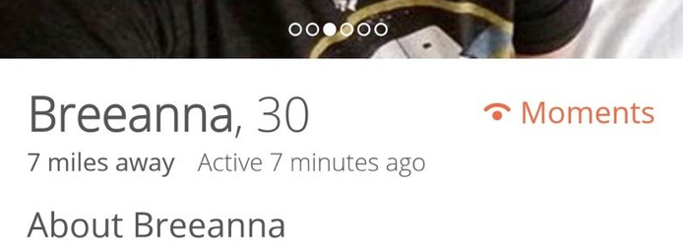
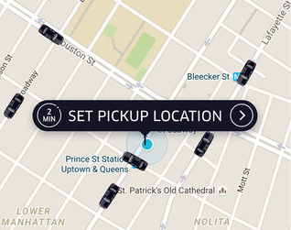
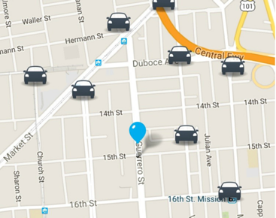
Broad Implications on Other Apps
Sybil device problem is not specific to Waze
  E.g. Foursquare, Yelp, Uber, Lyft, Tinder, Whisper
  We reverse engineer their APIs, and create light-weight clients using scripts
Tinder/Whisper
  Locate (triangulate) users
Uber/Lyft
  Track drivers
  Fake rides

Slide 17




Today
Good defense: Yik Yak
  Use HMAC^{[1]} to ensure message integrity
  Embed key in code
  Require decompiling code
Market for selling attack tools
  Plugin apps for Didi in China
  Spoof location
  Filter orders
  Snatch orders
[1] HMAC: Hash-based Message Authentication Code

Slide 18


Thank you!
Questions?

