Slide 1
With Great Training Comes Great Vulnerability: Practical Attacks against Transfer Learning
Bolun Wang*, Yuanshun Yao, Bimal Viswanath§
Haitao Zheng, Ben Y. Zhao
University of Chicago, * UC Santa Barbara, § Virginia Tech
bolunwang@cs.ucsb.edu

Slide 2
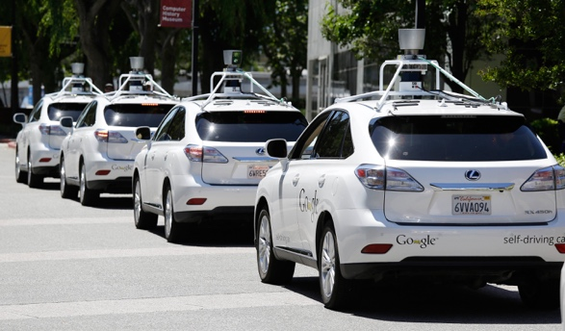
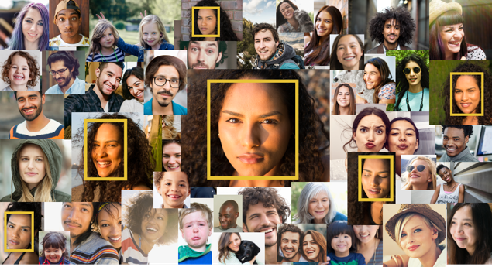
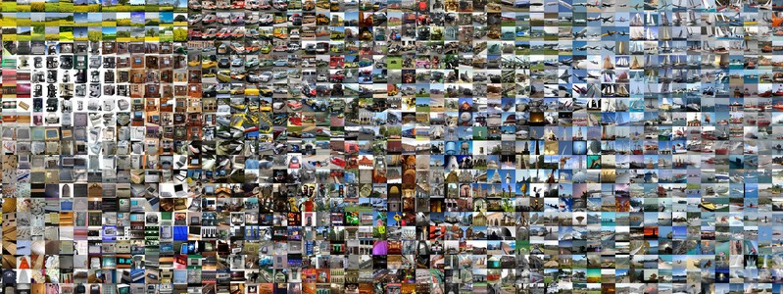
Deep Learning is Data Hungry
High-quality models are trained using large labeled datasets
Vision domain: ImageNet contains over 14 million labeled images
Where do small companies get such large datasets?

Slide 3
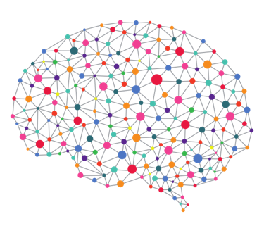
A Prevailing Solution: Transfer Learning
+
Company X
Limited
Training Data
Teacher
Highly-trained Model
Transfer and re-use pre-trained model
Student
High-quality Model
Recommended by Google, Microsoft, and Facebook DL frameworks
Student A
Student B
Student C

Slide 4
Deep Learning 101
Photo credit: Google

Slide 5
Transfer Learning: Details
Teacher
Student-specific classification layer
Student
Output
Teacher-specific classification layer
Output
Insight: high-quality features can be re-used
$N$ Layers
$N−1$ Layers
In general, first $K$ layers can be directly transferred
($K=N−1$)
Input
Input

Slide 6
Transfer Learning: Example
Face recognition: recognize faces of 65 people
Student
Transfer 15 out of 16 layers
Teacher
(VGG-Face)
Company X
10 images/person
65 people
900 images/person
2,622 people
Classification Accuracy
Without Transfer Learning | With Transfer Learning
1% | 93.47%

Slide 7
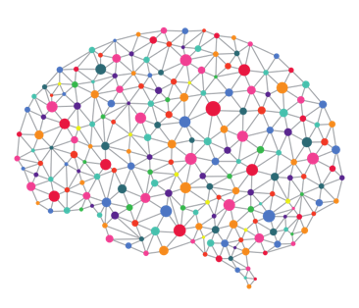
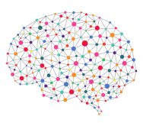
Is Transfer Learning Safe?
Transfer Learning lacks diversity
Users have very limited choices of Teacher models
Same Teacher
Help attacker exploit all Student models
Company A
Company B
Attacker

Slide 8
In This Talk
Adversarial attack in the context of Transfer Learning
Impact on real DL services
Defense solutions

Slide 9
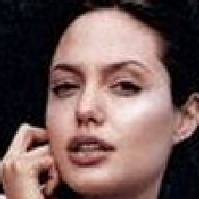
Background: Adversarial Attack
Adversarial attack
Misclassify inputs by adding carefully engineered perturbation
$$+ ε∙$$
Misclassified as
Imperceptible perturbation

Slide 10
Attack Models of Prior Adversarial Attacks
White-box attack: assumes full access to model internals
Find the optimal perturbation offline
Black-box attack: assumes no access to model internals
Repeated query to reverse engineer the victim
Test intermediate result and improve
Not practical
Easily detected

Slide 11
Our Attack Model
We propose a new adversarial attack targeting Transfer Learning
Attack model
Teacher
Student
White-box
Model internals are known to the attacker
Black-box
Model internals are hidden and kept secure
Default access model today
Teachers are made public by popular DL services
Students are trained offline and kept secret

Slide 12
Attack Methodology: Neuron Mimicry
$$F(∙)$$
$$G(∙)$$
If two inputs match at layer $K$, then they produce the same result regardless of changes above layer $K$.
Target
Image
$$X_{K}$$
$$F(X_{K})$$
$$G(F\left(X_{K}\right))$$
Same as Teacher
$$X_{K}$$
$$F(X_{K})$$
$$G(F\left(X_{K}\right))$$
+
Perturbation
$$∆$$
Source
Image
$$F(∙)$$
$$G(∙)$$

Slide 13
How to Compute Perturbation?
Compute perturbation ($∆$) by solving an optimization problem
Goal: mimic hidden-layer representation
Constraint: perturbation should be indistinguishable by humans
$X_{s}$: source image
$X_{t}$: target image
$T_{K}\left(X\right)$: internal representation at layer $K$ of image $X$
Minimize L2 distance between internal representations
$\min{ Distance(T_{K}\left(X_{s}+∆\right), T_{K}(X_{t}))}$
$s.t. perturb_magnitude\left(X_{s}+∆, X_{s}\right)<P_{budget}$
DSSIM: an objective measure for image distortion
Constrain perturbation

Slide 14
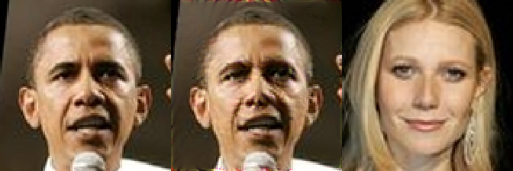
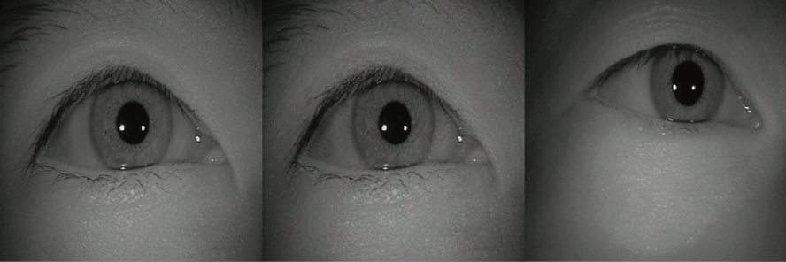
Attack Effectiveness
Targeted attack: randomly select 1,000 source, target image pairs
Attack success rate: percentage of images successfully misclassified into the target
Source
Adversarial
Target
Source
Adversarial
Target
Face recognition
92.6% attack success rate
Iris recognition
95.9% attack success rate

Slide 15
Attack in the Wild
Q1: given Student, how to determine Teacher?
Craft “fingerprint” input for each Teacher candidate
Query Student to identify Teacher among candidates
Q2: would attack work on Students trained by real DL services?
Follow tutorials to build Student using following services
Attack achieves >88.0% success rate for all three services
Teacher A
Which Teacher is used?
Teacher B
Student
Fingerprint input

Slide 16
In This Talk
Adversarial attack in the context of Transfer Learning
Impact on real DL services
Defense solutions

Slide 17
Intuition: Make Student Unpredictable
Modify Student to make internal representation deviate from Teacher
Modification should be unpredictable by the attacker → No countermeasure
Without impacting classification accuracy
Maintain classification accuracy
Teacher
Updated objective function
$\min{ CrossEntropy(y_{true}, y_{pred})}$
$s.t. {\left\|T_{K}\left(x\right)−S_{K}(x)\right\|}_{2}>D_{th} for x∈X_{train}$
Transfer using an updated objective function
Robust
Student
Guarantee difference between Teacher and Student

Slide 18
Effectiveness of Defense
Model |  | Face Recognition | Iris Recognition
Before Patching | Attack Success Rate | 92.6% | 100%
After Patching | Attack Success Rate | 30.87% | 12.6%
 | Change of Classification Accuracy | ↓ 2.86% | ↑ 2.73%

Slide 19
One More Thing
Findings disclosed to Google, Microsoft, and Facebook
What’s not included in the talk
Impact of Transfer Learning approaches
Impact of attack configurations
Fingerprinting Teacher
…

Slide 20
Code, models, and datasets are available at https://github.com/bolunwang/translearn
Thank you!

