Slide 1
Anatomy of a Personalized Livestreaming System
Bolun Wang, Xinyi Zhang, Gang Wang*, Haitao Zheng, Ben Y. Zhao
UC Santa Barbara
*Virginia Tech
bolunwang@cs.ucsb.edu

Slide 2
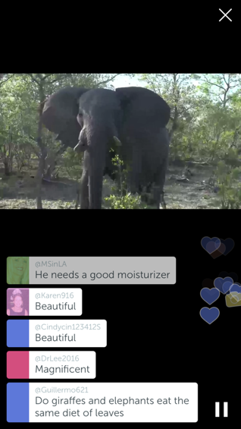
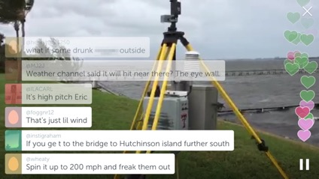
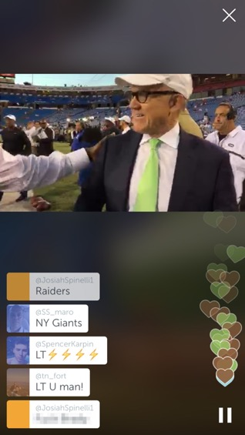
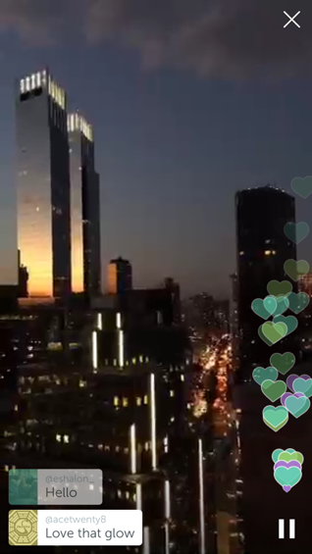
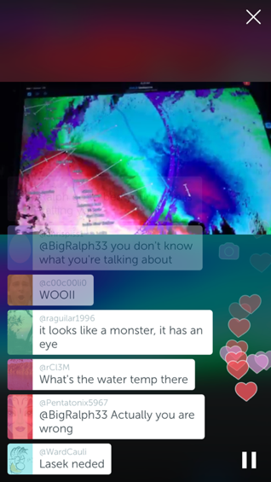
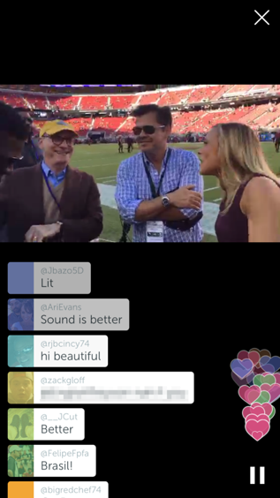
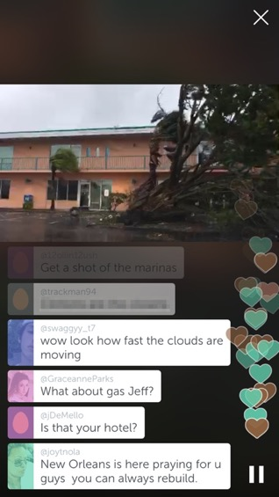
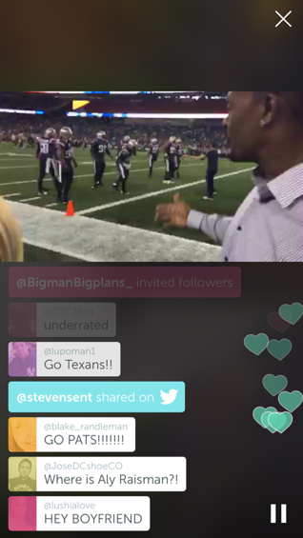
Personalized Livestreaming
Travel
Hurricane Matthew
NFL
Interactivity is the Key!

Slide 3



Personalized Livestreaming is Hard
Livestreaming
Personalized Livestreaming
Video
Interactions
Video
CDN
Low video delay
Viewer
Viewer
Viewer
Viewer
Is scalability going to be a problem?
Viewer
Viewer
Viewer
Viewer

Slide 4
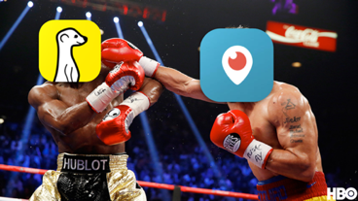
Outline
Scale, growth, usage pattern
  Periscope and Meerkat
Fundamental tradeoffs between scalability and interactivity
  Dissection of Periscope
Recent changes of Periscope

Slide 5


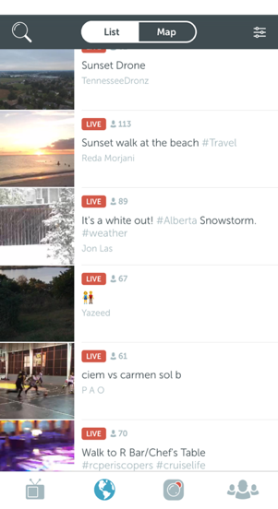

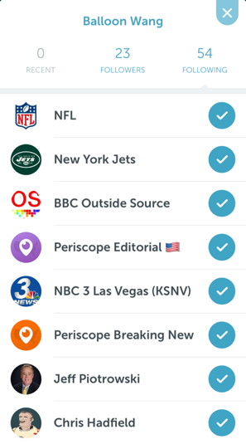
Available Data
Interactions within broadcasts
  Comments and hearts
  Viewer joining
  All events have timestamps
Livestream video
  Arrival time of each video frame
Social graph
  Follower/followee relationship

Slide 6
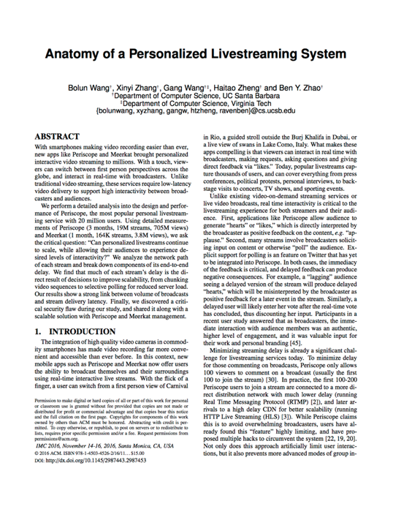
Data Collection Methodology
Broadcast meta data
  Script fully emulating Periscope and Meerkat API calls
  Monitor public list for new broadcasts
Interactions within broadcasts
  Join new broadcasts and collect interactions
Interacted frequently with Periscope and Meerkat
  They are aware of our research
  Identify security vulnerabilities

Slide 7


Broadcast Interaction Dataset Size
May 12
2015
May 15
2015
June 15
2015
Aug. 20
2015
Time
Publicly available
Meerkat
Periscope
All public broadcasts for 1+ month
164K broadcasts from 57K broadcasters
1.9M comments and 525K hearts
All public broadcasts for 3+ months
19.6M broadcasts from 1.8M broadcasters
549M comments and 7.98B hearts

Slide 8
Scale of Livestreaming Services
Large daily broadcast traffic
Periscope: 472k daily broadcast in May 2016
Periscope’s volume tripled in 3 months
Meerkat’s volume halved in 1 month
Meerkat shut down in Sep. 2016

Slide 9


Broadcasts are Highly Interactive
~1.3M Periscope broadcasts: >100 comments & >1k hearts
~100x
~10x
134k
comments
1.35M
hearts
“Commenter limit” is constraining
Especially in popular broadcasts
57.6k broadcasts: >1k viewers
Trending broadcasts: >700k viewers
More hearts than comments
Caused by “100-commenter limit”
Only first 100 viewers can comment
≠ viewers want to comment
More hearts than comments
This limit is correlated with Periscope’s CDN design

Slide 10
Outline
Scale, growth, usage pattern
  Periscope and Meerkat
Fundamental tradeoffs between scalability and interactivity
  Dissection of Periscope
Recent changes of Periscope

Slide 11
Anatomy of Periscope
Video Channel
Messaging Channel
Long latency
Broadcaster
Near
real-time
Broadcaster
Video
+
Wowza
Fastly
PubNub
Comment
Heart
Viewer
Viewer
Viewer
Viewer
Viewer
Viewer
Viewer
Viewer

Slide 12


Livestream Delivery Infrastructure
Video
frame
Video
chunk
RTMP
Wowza
Fastly
Broadcaster
RTMP
HLS
More viewers = High load
Scalable
But long delay
Viewers
Viewers
Sender pushes each video frames to the receiver
RTMP for smaller audience
Receiver polls the server for large video chunks
HLS for larger audience

Slide 13
Implications of the Infrastructure
Only the first 100 viewers can comment. Why?
RTMP
Wowza
HLS
Fastly
Broadcaster
Limit: 100
Low latency
↓
Able to comment
Long latency
↓
Lagging comment

Slide 14
End-to-end Delay in Lab Settings
10 broadcasts in stable lab Wi-Fi
RTMP
(Wowza)
1.45s
HLS
(Fastly)
11.67s
Which components of the system cause the long delay in HLS?

Slide 15
Delay Breakdown in Lab Settings
RTMP
(Wowza)
1.16s
3.01s
1.17s
6.88s
HLS
(Fastly)
Chunking
Upload
Wowza2Fastly
RTMP
Wowza
HLS
Fastly
Broadcaster
Last Mile
Polling
Last Mile
Viewers
Buffering
Viewers
Buffering

Slide 16
How to Reduce HLS Delay?
Reduce major delay components
  Chunking delay: smaller chunks
  Polling delay: more frequent polling
  Buffering: less buffer
Use measurement to understand
  How system parameters affect delay components?
  What other effects on the system?
Simulation on broadcasts in the wild
  16K randomly selected broadcasts
  Scripts emulate as viewers

Slide 17
Optimizing Client-side Buffering
Simulation: buffering delay vs. playback smoothness
  Strategy: pre-buffer P seconds before playback
  Stalling time: duration of video freezing
Save 3s buffering delay with low impact on smoothness
~3s

Slide 18
Recent Updates of Periscope
Allow more viewers to comment
  Reduce HLS delay so HLS viewers can comment
Major changes of Periscope
  Smaller HLS chunks: 3s → 2s
  Smaller polling interval: 3s → 1s
  Smaller buffer: 9s → 6s
CDN design and protocol design remains the same

Slide 19
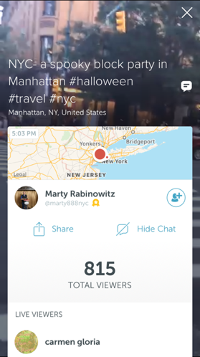

Periscope Dataset Available
75 continuous days of Periscope public broadcasts
  13.9M broadcasts
  416M comments
  6.1B hearts
In each broadcast
  Meta data: title, time, broadcaster, location, etc.
  Interactions: comments, hearts, join, invite, etc.

Slide 20

Dataset is available at
http://sandlab.cs.ucsb.edu/periscope
http://bit.ly/periscope-data
Thank you!
Questions

